Slide 1

Data + Information Architecture
data-action-lab.com

Slide 2
This Session's Learning Objectives
Primary objective: Increase your awareness of what you need to consider on the data front in order to run, manage, create and instigate successful data-driven projects.
Supporting objectives:
be exposed to many of the concepts and terms at play in today’s data world – e.g. data model, many-to-many relationship, database, noSQL, query, data management.
experience creating a conceptual model and then turning this into a particular type of data model, based on a use-case.

Slide 3

Something Old, Something New?
Since you all have been chosen for the data stream, perhaps you are all already ‘data people’.
Many of these concepts and skills will be somewhat familiar to you already.
However – data and knowledge architecture concepts are critical in designing a data-driven project, so we can’t just assume you are!
Hopefully some new concepts for everyone, still! Ontologies, any one?

Slide 4
SOME CONTEXT

Slide 5
The (Messy) Analysis Process
Objective/
Rationale
Utilization and Decision Support
Data Collection
Data Exploration
Infrastructure and Data Management
Data Preparation
Modeling and Analysis
Communication

Slide 6
An Implemented (Automated) DATA Pipeline
In the service delivery context, you may eventually want one of these…
(9 component parts)
(as always - beware model ‘drift’!)

Slide 7


An Implemented (Automated) DATA Pipeline

Slide 8
Data Sources

Slide 9
Group Discussion: A Few Fundamental Data Questions
Why do we collect data? What can we do with data?
Where does data come from?
Assuming we collect data so we can have a collection of data – what does ‘a collection’ of data look like? How would you describe one?
Do we need to distinguish between data, information, knowledge?

Slide 10
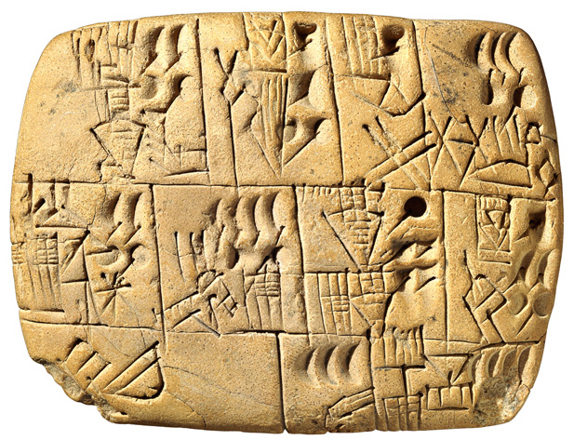
What Is This?

Slide 11

Motivations For Collection
Three functions, historically:
Record Keeping (People/Societal Management!)
Science - New General Knowledge
Intelligence - Business, Military, Police, Social? Domestic? Personal!

Slide 12
Motivations For Collection
Each of these three functions have traditionally used different sources of information.
They have collected different types of data.
They also have had different data cultures and terminologies!
In data science (interdisciplinary!) we may run into all of them on the same project.

Slide 13
Different Data Cultures, Different Terms
Business Intelligence:
data warehouse + data mart
data 'dimension’ (= data set)
hierarchical data (slices)
data element
dimension table + fact table
Science/Statistics:
experimental data
trials
participants
variables
correlation
Record Management:
information architecture
file plan
information resource
field
form and subject
Data Science
Data
Knowledge
Information

Slide 14
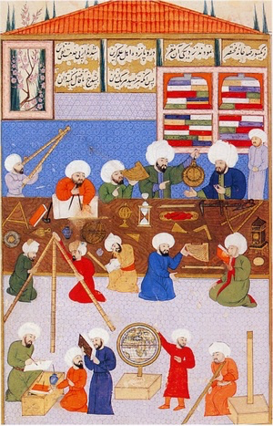
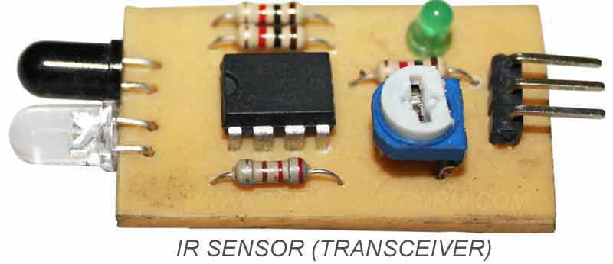
Some Sources OF DATA
records of activity
(scientific) observations
sensors + monitoring
computers!

Slide 15
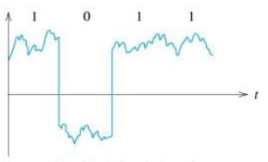
Enter Computers! And Computer Science!
Computer science (and information science) has its own theoretical, fundamental viewpoint about data, and information.
Computers operate over data in a fundamental sense - 1s and 0s that represent numbers, letters, etc. – data becomes digital.
Pragmatically, data is now stored on computers, and is accessible through our world-wide computer network.

Slide 16

Data IS REAL!
Data is a representation, but data is still physical!
Data has physical properties - it takes up physical space! It requires energy to work with it.

Slide 17

Data DECAYS
Data ages over time - it has a shelf life.
We use the phrase "rotten data” or "decaying data”:
literally - in the sense that the data storage medium might decay
metaphorically - when the data no longer accurately represents the relevant objects and relationships or even when those objects no longer exist in the same way
Your data must be ‘fresh’, ‘current’, not ‘stale’ (context and model dependent!)

Slide 18
Before The Data

Slide 19
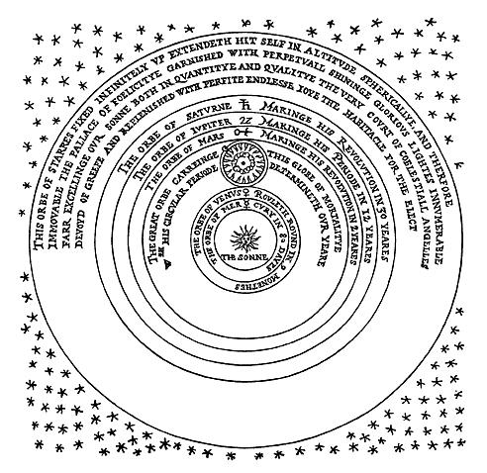
Core Concepts
How do we cut across all of the different disciplines that use data?
Core (systems) concepts or elements:
object – attributes (concrete or abstract)
multiple objects - relationships between these objects/attributes
how these elements change over time

Slide 20
Relationships Within Systems
some fundamental relationships:
part-whole
is-a
is-a-type-of
cardinality (one-to-one, one-to-many, many-to-many)
some more object specific relationships:
ownership,
social relationships
becomes,
leads-to

Slide 21
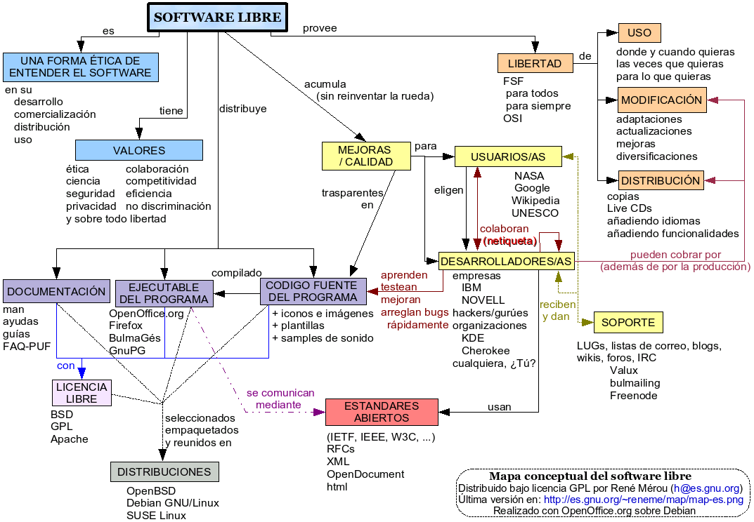
Conceptual Model of a System
A conceptual model is, roughly speaking:
a model that is not implemented (e.g. as a scale-model or computer code), but one which exists only conceptually
a diagram or verbal description of a system (e.g. boxes and arrows, mind maps, lists, definitions)
Focus is not necessarily on capturing specific behaviors but emphasizing possible states.
Focus is on object types, not on specific instances – goal is abstraction!

Slide 22
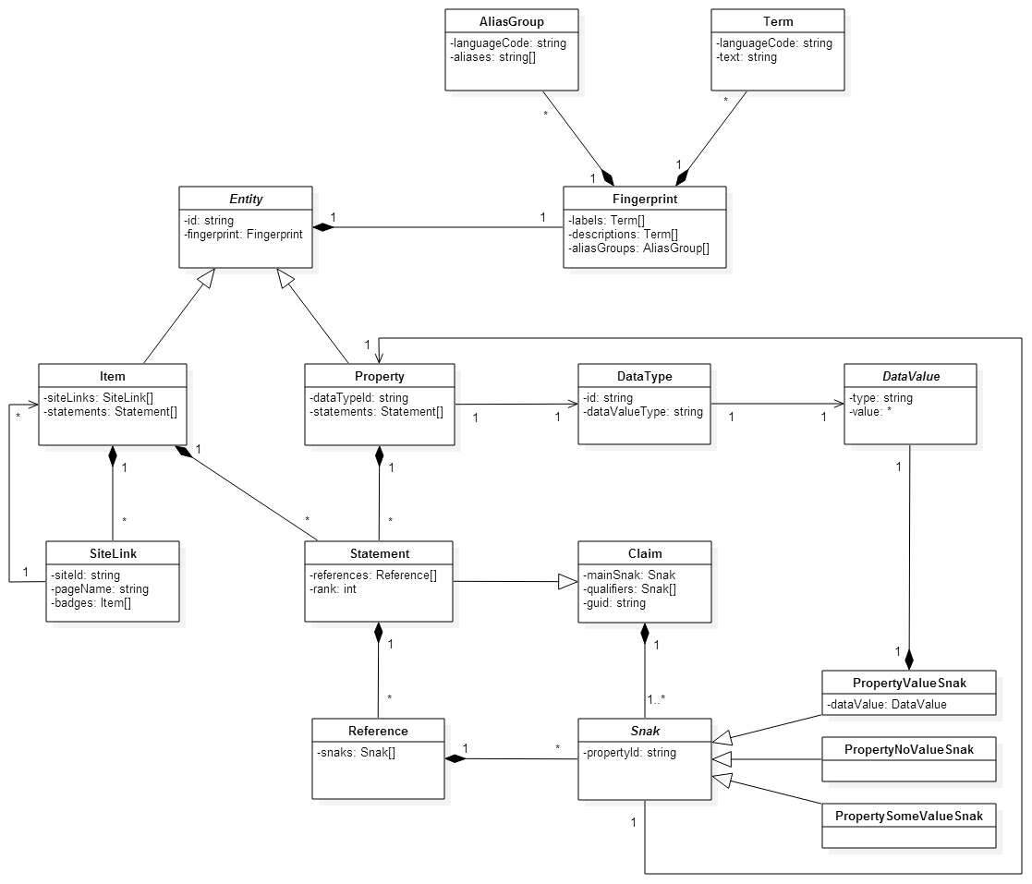
Formal Conceptual Modelling Languages
Conceptual modelling is not an exact science – it’s more about making your internal conceptual models explicit and tangible.
It provides you with an opportunity to examine and explore your ideas and assumptions.
That said, various efforts have been made to formalize conceptual modelling:
UML – Universal Modelling Language
Entity Relationship (ER) Models - but they are generally connected to relational databases

Slide 23
Putting this Into Practice
Pick a system of relevance to you, and generate a conceptual model that encompasses:
objects - especially key objects (could be abstract or concrete)
properties of these objects and values of these properties
relationships between objects (part-whole, is-a, object-specific, one-to-many)
relationships between properties across instances of an object type

Slide 24
Data And Knowledge Modelling

Slide 25
Methodological Models
Mathematical Model
Statistical Model
Conceptual Model
Programmatic (Computer) Model
Ontology (Knowledge Model)
(Simulation)
Data Model

Slide 26
An Implemented (Automated) DATA Pipeline
Do they match? Each other? The conceptual model?
Data Model
Mathematical Model
Statistical Model
Programmatic Model

Slide 27
Hold On To THOSE Fundamental CONCEPTS
How to structure your data and knowledge so that it can be:
usefully stored
added to
usefully and efficiently extracted from that store (extract – transform – load)
operated over by humans and computers (programs, bots, A.I.)

Slide 28
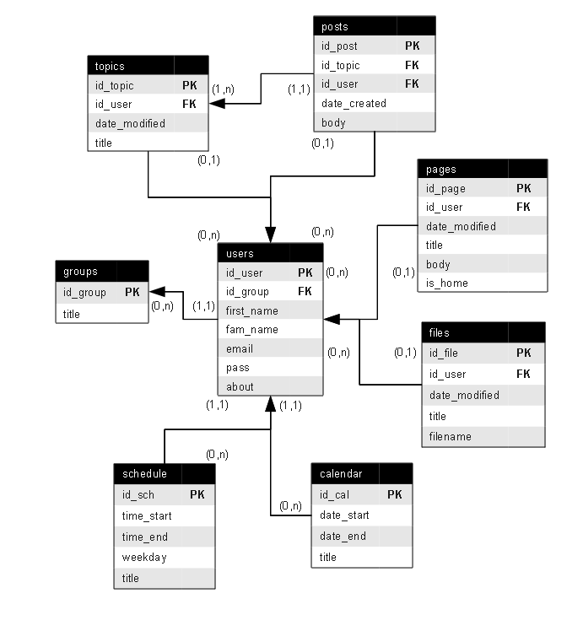
What Is Data Modelling
A data model is an abstract (logical) description of a system, constructed in terms that can then be implemented as the structure of a type of data management software.
You might argue that it is half way between a conceptual model and a database implementation.
The data itself is about instances – the model is about the object types.
There is another option that is worth considering on this front – ontologies.

Slide 29
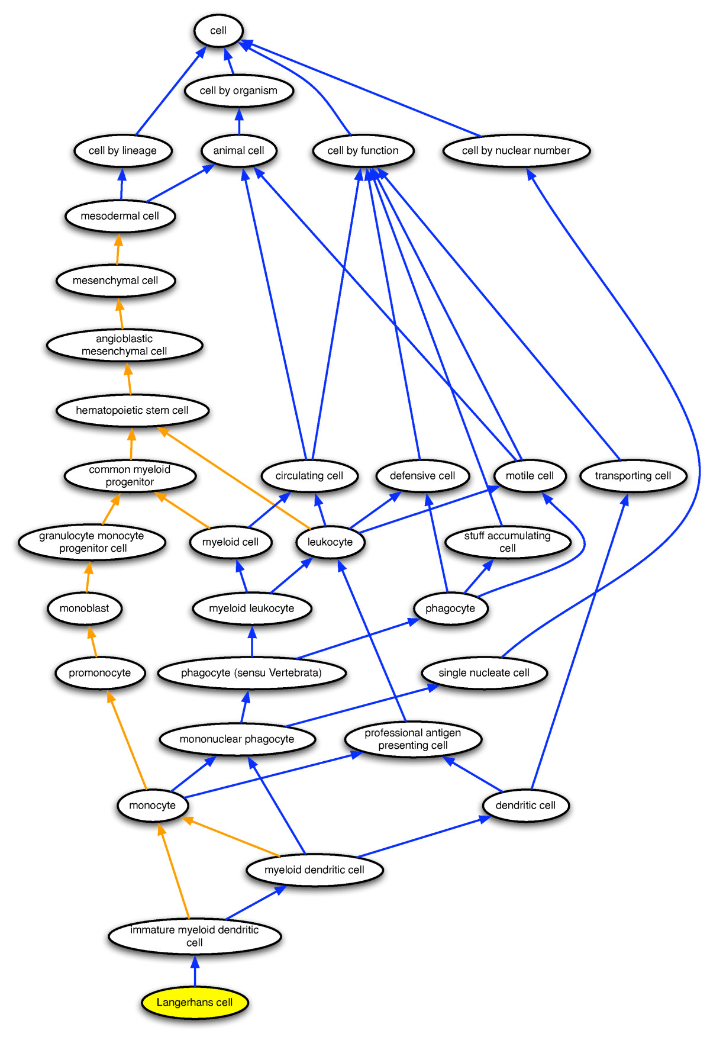
Ontology – Knowledge Model
A structured, machine-readable collection of facts about a domain.
Motivated by a desire to create increasingly machine readable but still conceptually sophisticated data.
you could describe in a slightly tongue in cheek manner as 'a data model on steroids’.
An attempt to get closer to the level of detail of a full conceptual model.

Slide 30
Metadata To Provide Context
We lose something when we move from our conceptual model to a specific type of model – e.g. the data or knowledge model.
One way of keeping the context is to provide (hopefully rich) metadata – data about our data!
Metadata is crucial when it comes to carrying out strategies for working across datasets.
Ontologies can also play a role here!

Slide 31

Structured vs Unstructured Data
A major motivator for some of the new developments in types of databases and other data storing strategies is the increasing availability of unstructured data and also 'blob' data.
Structured Data: labelled, organized, discrete, structure is constrained and pre-defined
Unstructured Data: not organized, no specific pre-defined structure data model – e.g. text in a document
Blob Data: Binary Large Object (BLOb) – images, audio, multi-media

Slide 32
What Is Data Modelling
We're going to look at four different options that are currently popular in terms of fundamental data and knowledge modelling or structuring strategies:
key-value pairs (e.g. JSON)
triples (e.g. resource description framework (RDF))
graph databases
relational databases
NoSQL

Slide 33
Key - value stores and triple stores
These are relatively unstructured ways to store data:
Key Value: all data is simply stored as a giant list of keys and values, where the key is a name or label (possibly of an object) and the value is a value associated with this.
Triple: Data is stored as subject – predicate – object

Slide 34
Examples
apple type - apple colour
Granny Smith - green
Red Delicious – red
person - shoe size
Jen Schellinck - women's size 7
Colin Henein - men's size 10
word - definition
url – webpage
report name – report (document file)
Triples add a verb to the mix:
Person - is - age
Object - is-colour - colour

Slide 35
Nailing Down The Details
Both strategies results in a large amount of flexibility when it comes to the 'design' of the data storage.
In terms of the implementation of these data models the devil is in the details, and their extreme flexibility can add to this challenge.
See for example: https://softwareengineering.stackexchange.com/questions/321534/what-json-structure-to-use-for-key-value-pairs

Slide 36
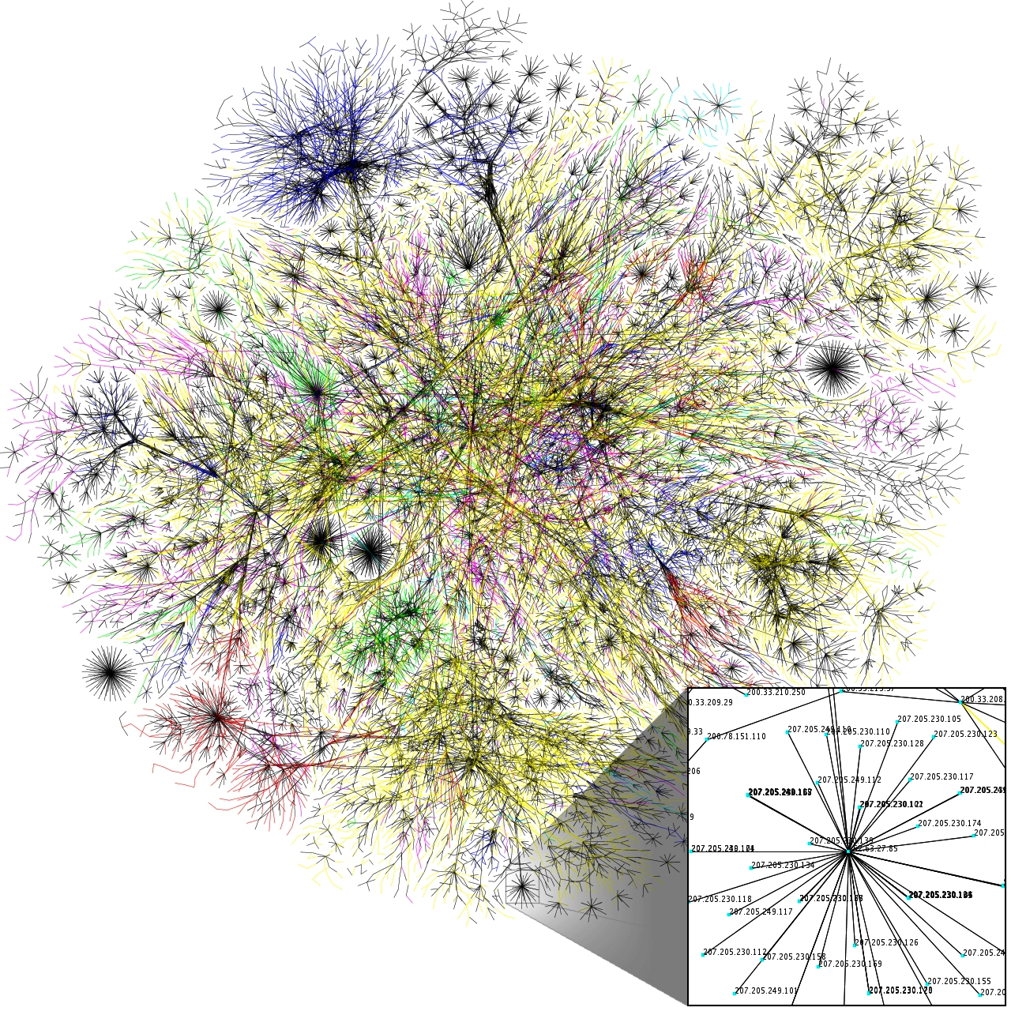
Graph Databases
Emphasis on the relationships between different types of objects, rather than between an object and the properties of that object.
The data model:
objects represented by nodes
relationships between these objects represented by edges
objects can have a relationship with other objects of that same type - person is-a-sibling-of person

Slide 37
Relational databases
Data stored in a series of tables
Broadly speaking, each table represents an object and some properties related to this object.
Special columns in tables connect object instances across table.

Slide 38


Relational databases
Example: I live in a house that has a particular address.
Sometimes the property of the house will be stored in the table that stores information about me.
In other cases it will make more sense to store information about the house in its own table.
The form of relational databases are driven by whether or not relationships are one-to-one, one-to-many or many-to-many (cardinality)

Slide 39
Putting It INTO Practice
Come up with an example of a one to one, one to many and many to many relationship? How clear cut is the cardinality of this relationship?
What is the cardinality of the father to child relationship?

Slide 40
Pros, Cons and Use Cases of Each
Relational Database: widely supported, well understood, works well for many types of systems and use cases. But difficult to change once implemented, doesn't deal with relationships well (despite the name).
Key-Value Stores: can take any sort of data, don't need to know much about it's structure advance, if you have many missing values these won't take up space. But can be messy and mysterious, difficult to find data.
Graph Databases: fast and intuitive if you are using heavily relation-based data, might be the only option if your data is like this because traditional databases may slow to a crawl. But probably overkill/too specialized if your data is not like this, not yet widely supported.

Slide 41
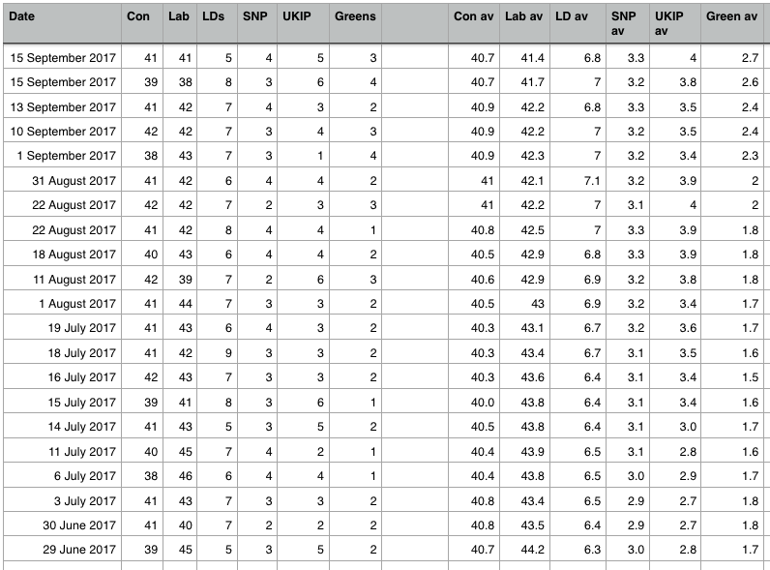
A note on flat files and spreadsheets
What about keeping your data in a single giant table (spreadsheet)? Or multiple spreadsheets? How bad can it be?
Wayne Eckerson coined the term ‘spreadmart’ (as opposed to data mart) to describe a situation with many (ad hoc) spreadsheets as a data strategy.

Slide 42
A note on flat files and spreadsheets
Pros - very efficient if you are only collecting data once, about one particular type of object (e.g. scientific studies!), some types of analysis require you to have all the data in one place, so you are going to need to generate a flat file anyway. Easy to read into analysis software (e.g. R) and do operations over the entire dataset
Cons - very hard to manage data integrity over the long term if you are continually collecting and working with the data. Doesn't work well if you are dealing with data on a system involving many different types of objects and their relationships. Can be very difficult to carry out data querying operations

Slide 43
Some Tools and Buzzwords
Linked Data
Semantic Web
Web Ontology Language (OWL)
Protégé
MongoDB, ArangoDB
Document store
JSON, YAML
API, GraphQL

Slide 44
Putting IT Into Practice
Take a look at the conceptual model you've created for your system.
Pick one way you might want to use data or knowledge about this system.
Which type of data or knowledge model do you think is most appropriate for this system and use case?
Create an appropriate data or knowledge model from your conceptual model.

Slide 45
Implementing Your Model

Slide 46
Implementing Your Model
To implement your data/knowledge model, you need to have access to data storage and management software.
Access might be challenging for you, the individual, because traditionally such software runs on servers.
Servers are good because they allows many people to access a single database at the same time, from different client programs. However, it makes it hard to 'play' with a database.
SQLite to the rescue!

Slide 47

Relationship Between Program and Data

Slide 48
Role of Data Management Software
Data management software provides humans with an easy way to interact with their data.
It’s essentially a human – data – interface.
Through this interface you can:
add data to your data collection
extract subsets of data from your collection based on certain criteria
delete or edit data in your collection

Slide 49
A Data What???
Previously:
Database
Data warehouse
Data Marts
Database Management System
(SQL)
Now:
Data Lake
Data Pool
Data swamp?
Data graveyard?
(NoSQL)
Increasingly more of a distinction between the data store and the data management software

Slide 50
IN THIS COURSE: SQLite To THE RESCUE
SQLite is a standalone relational database that is installed on your Surfaces.
Let's take a quick look at the SQLite installation now!

Slide 51
From Data Model TO Implementation
What do we do once we’ve completed a (logical) data model?
instantiate the model in your chosen software (e.g. create tables in MySQL)
load the data
query the data:
Traditional relational databases use Structured Query Language (SQL)
Other types of databases use entirely different query languages (AQL, semantic engines, etc.) or rely on bespoke computer programs (e.g. written in R, Python)

Slide 52
Data Collection Management
Once you’ve created a data collection, you must also manage it! What does this mean? Fundamentally, it means maintaining data in the database that is:
accurate,
precise,
consistent
complete
Don’t let your data lake turn into a data swamp…

Slide 53
Extras

Slide 54
Relational Databases – DEEP Dive
Learning how to properly structure a relational database is a useful skill- there are many best practices related to this.
This is beyond the scope of this course!
However, as an extra activity, you may wish to try implementing your data model in your SQLite database.

Slide 55
Attributions and References

Slide 56
Image ATTRIBUTIONS (I)
Person with graph: https://www.flaticon.com/free-icon/person-explaining-strategy-on-a-board-with-a-sketch_38792
Digital Signal: By Mcanet - Own work, CC BY 3.0, https://commons.wikimedia.org/w/index.php?curid=6024833
An infrared sensor: https://commons.wikimedia.org/wiki/File:Infrared_Transceiver_Circuit.jpg#/media/File:Infrared_Transceiver_Circuit.jpg
Server room: https://upload.wikimedia.org/wikipedia/commons/9/98/Wikimedia_Servers-0051_10.jpg
Two bits flipped image: By Jim Salter - Own work, CC BY-SA 4.0,https://commons.wikimedia.org/w/index.php?curid=64046994
Système solaire selon Thomas Digges: By Jeangagnon - Wikipedia anglais, Public Domain, https://commons.wikimedia.org/w/index.php?curid=3155015
UML diagram of the Wikibase Data Model: https://upload.wikimedia.org/wikipedia/commons/4/4a/Wikibase_Conceptual_Data_Model.png
Conceptual map of Free Software (Spanish): By René Mérou h(at)es.gnu.org - http://www.es.gnu.org/~reneme/mapa-conceptual-software-libre.png (http://www.es.gnu.org/), CC BY-SA 3.0, https://commons.wikimedia.org/w/index.php?curid=1377588

Slide 57
Image ATTRIBUTIONS (II)
Entity – Relationship Model: https://commons.wikimedia.org/wiki/File:Entity-Relationship_Model_(diagram).png
An improved ontological representation of dendritic cells as a paradigm for all cell types: By Masci AM, Arighi CN, Diehl AD, Lieberman AE, Mungall C, Scheuermann RH, Smith B, Cowell LG -, CC BY 2.0, https://commons.wikimedia.org/w/index.php?curid=7355297
Blob of solar material: By NASA Goddard Space Flight Center from Greenbelt, MD, USA - Twisting Blob of Plasma, Public Domain, https://commons.wikimedia.org/w/index.php?curid=51482685
Partial map of the internet: By The Opte Project - Originally from the English Wikipedia; description page is/was here., CC BY 2.5, https://commons.wikimedia.org/w/index.php?curid=25698718
Ottoman astronomers: https://commons.wikimedia.org/w/index.php?curid=4932717

